Slide 1

Tanzu Community Edition (TCE)
Rudi Martinsen
Senior Systems Engineer
rudi.martinsen@proact.no
https://proact.eu
@RudiMartinsen
https://rudimartinsen.com
Notes:
***UPDATE URL ON SLIDE***

Slide 2

whoami
Rudi Martinsen
Senior Systems Engineer, Proact IT Norge AS
Senior Consultant, VMware PSO
vExpert 2018-2022
App Modernization, Cloud Management, Avi
Tanzu Vanguard
VMUG Norway Leader
Twitter: @RudiMartinsen
Blog: rudimartinsen.com

Slide 3
Agenda
Tanzu Overview
Tanzu Community Edition
Demos!

Slide 4
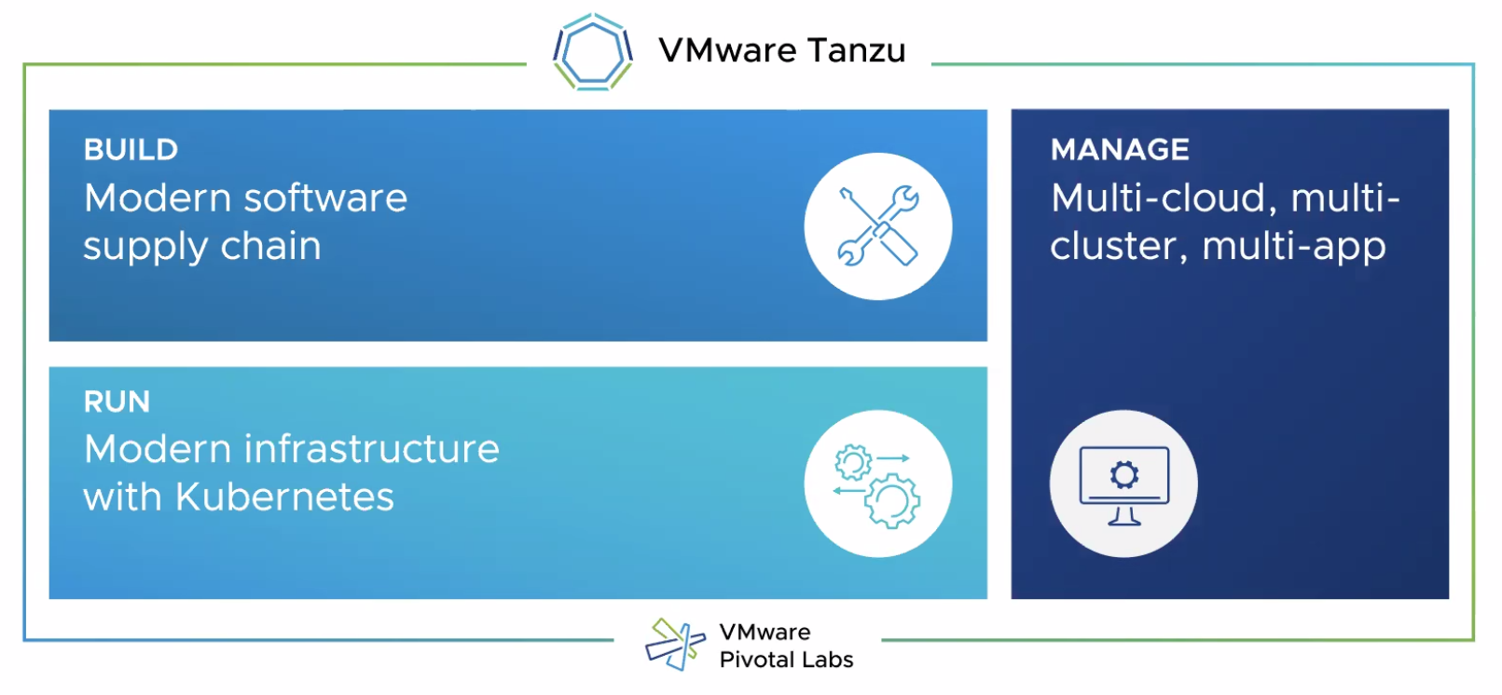
Tanzu Overview

Slide 5
Three (four) “flavors” of Tanzu
TKG
Tanzu Kubernetes Grid
TKGm (multi-cloud)
Runs on vSphere, AWS or Azure
vSphere with Tanzu
TKGs (service)
Runs on vSphere 7 and VCF
TKGI
Tanzu Kubernetes Grid Integrated Edition
A.k.a PKS
Tanzu Community Edition (TCE)

Slide 6
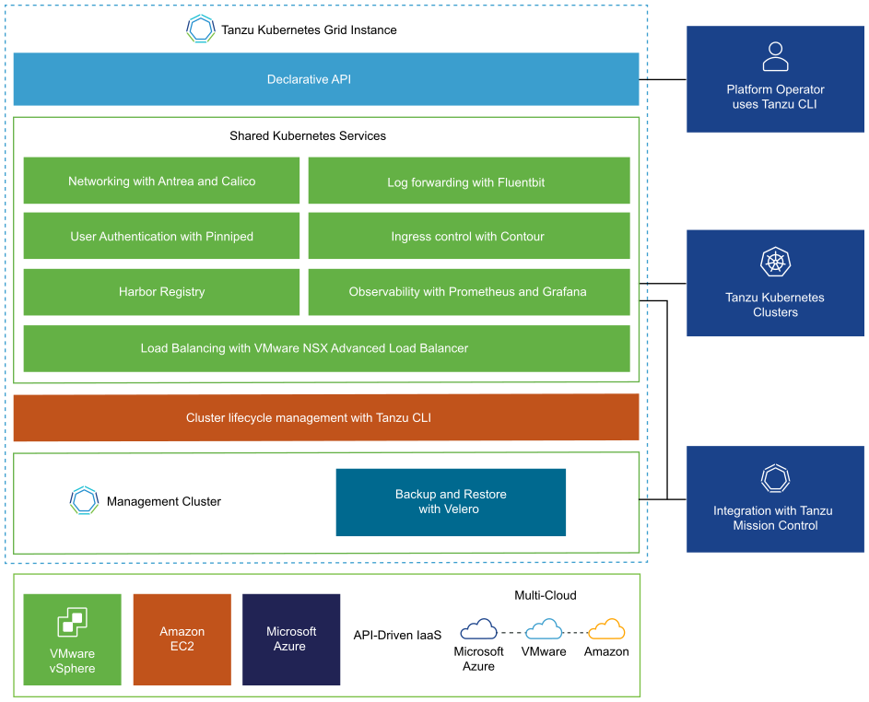
Tanzu Kubernetes Grid (TKG)

Slide 7
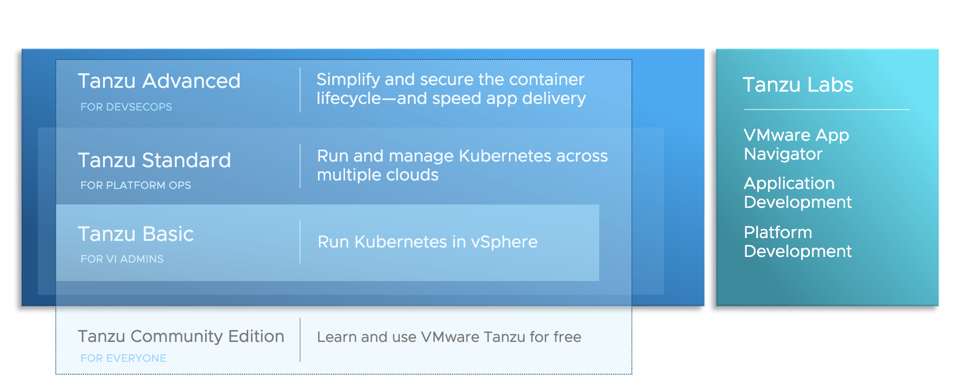
Tanzu Editions

Slide 8
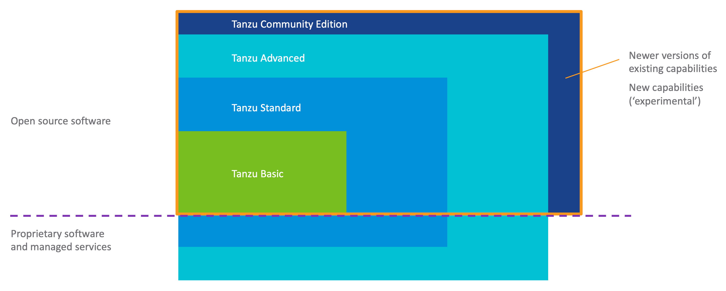
Tanzu Editions

Slide 9
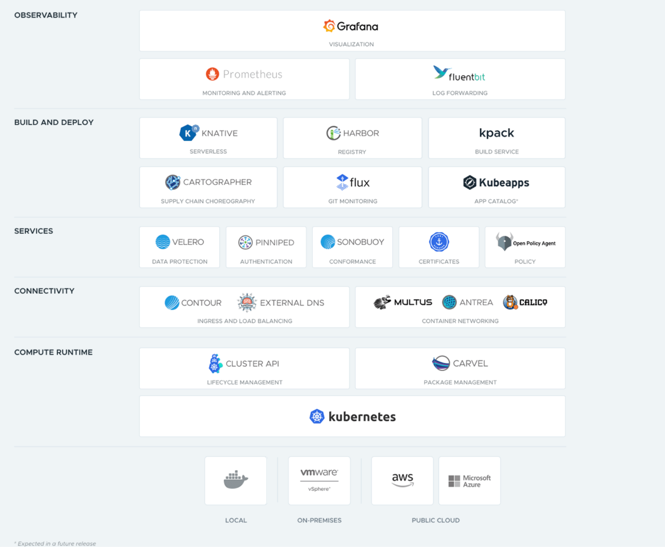
Tanzu Community Edition

Slide 10
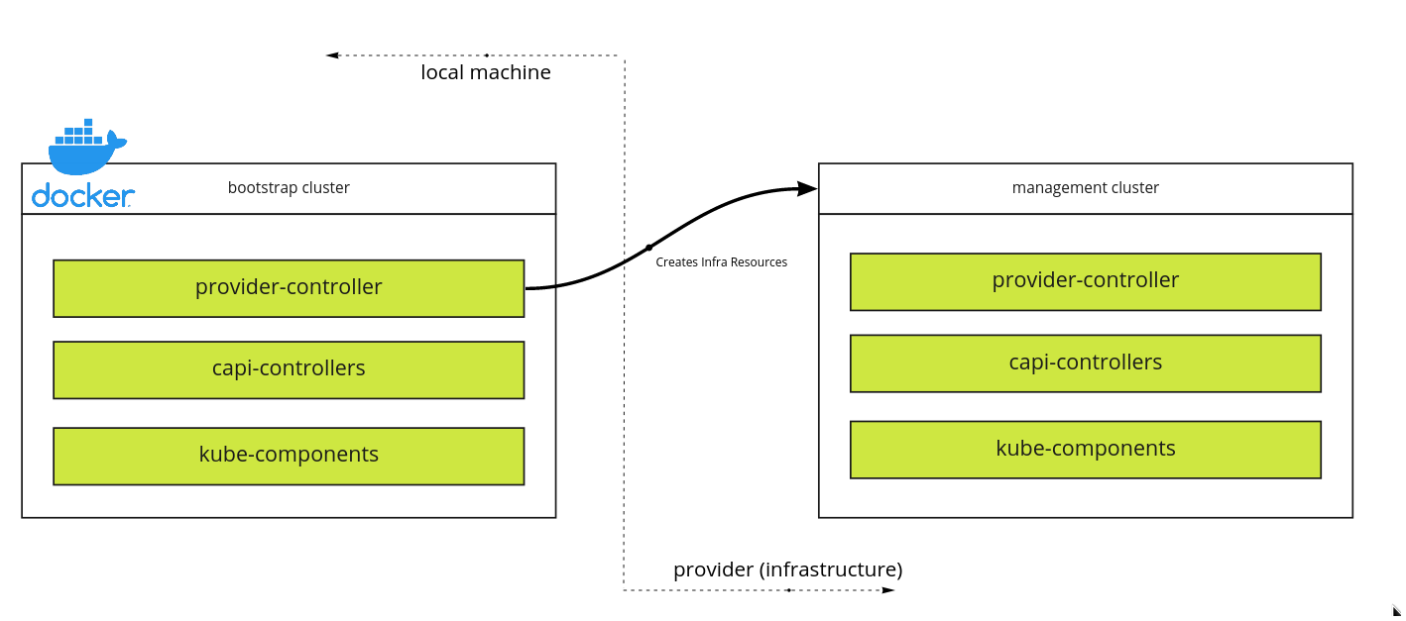
Deploy TCE Management cluster

Slide 11
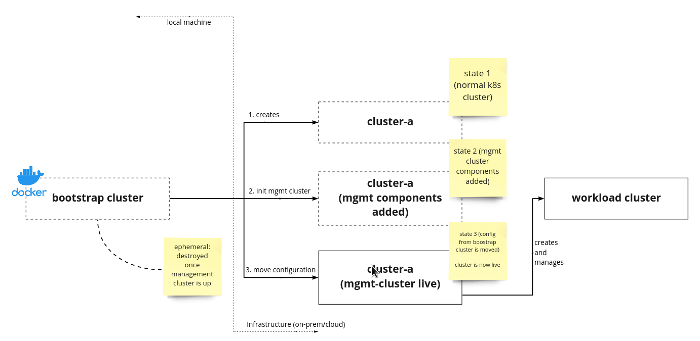
Cluster lifecycle

Slide 12
Demo

Slide 13
Cluster lifecycle

Slide 14
Demo

Slide 15
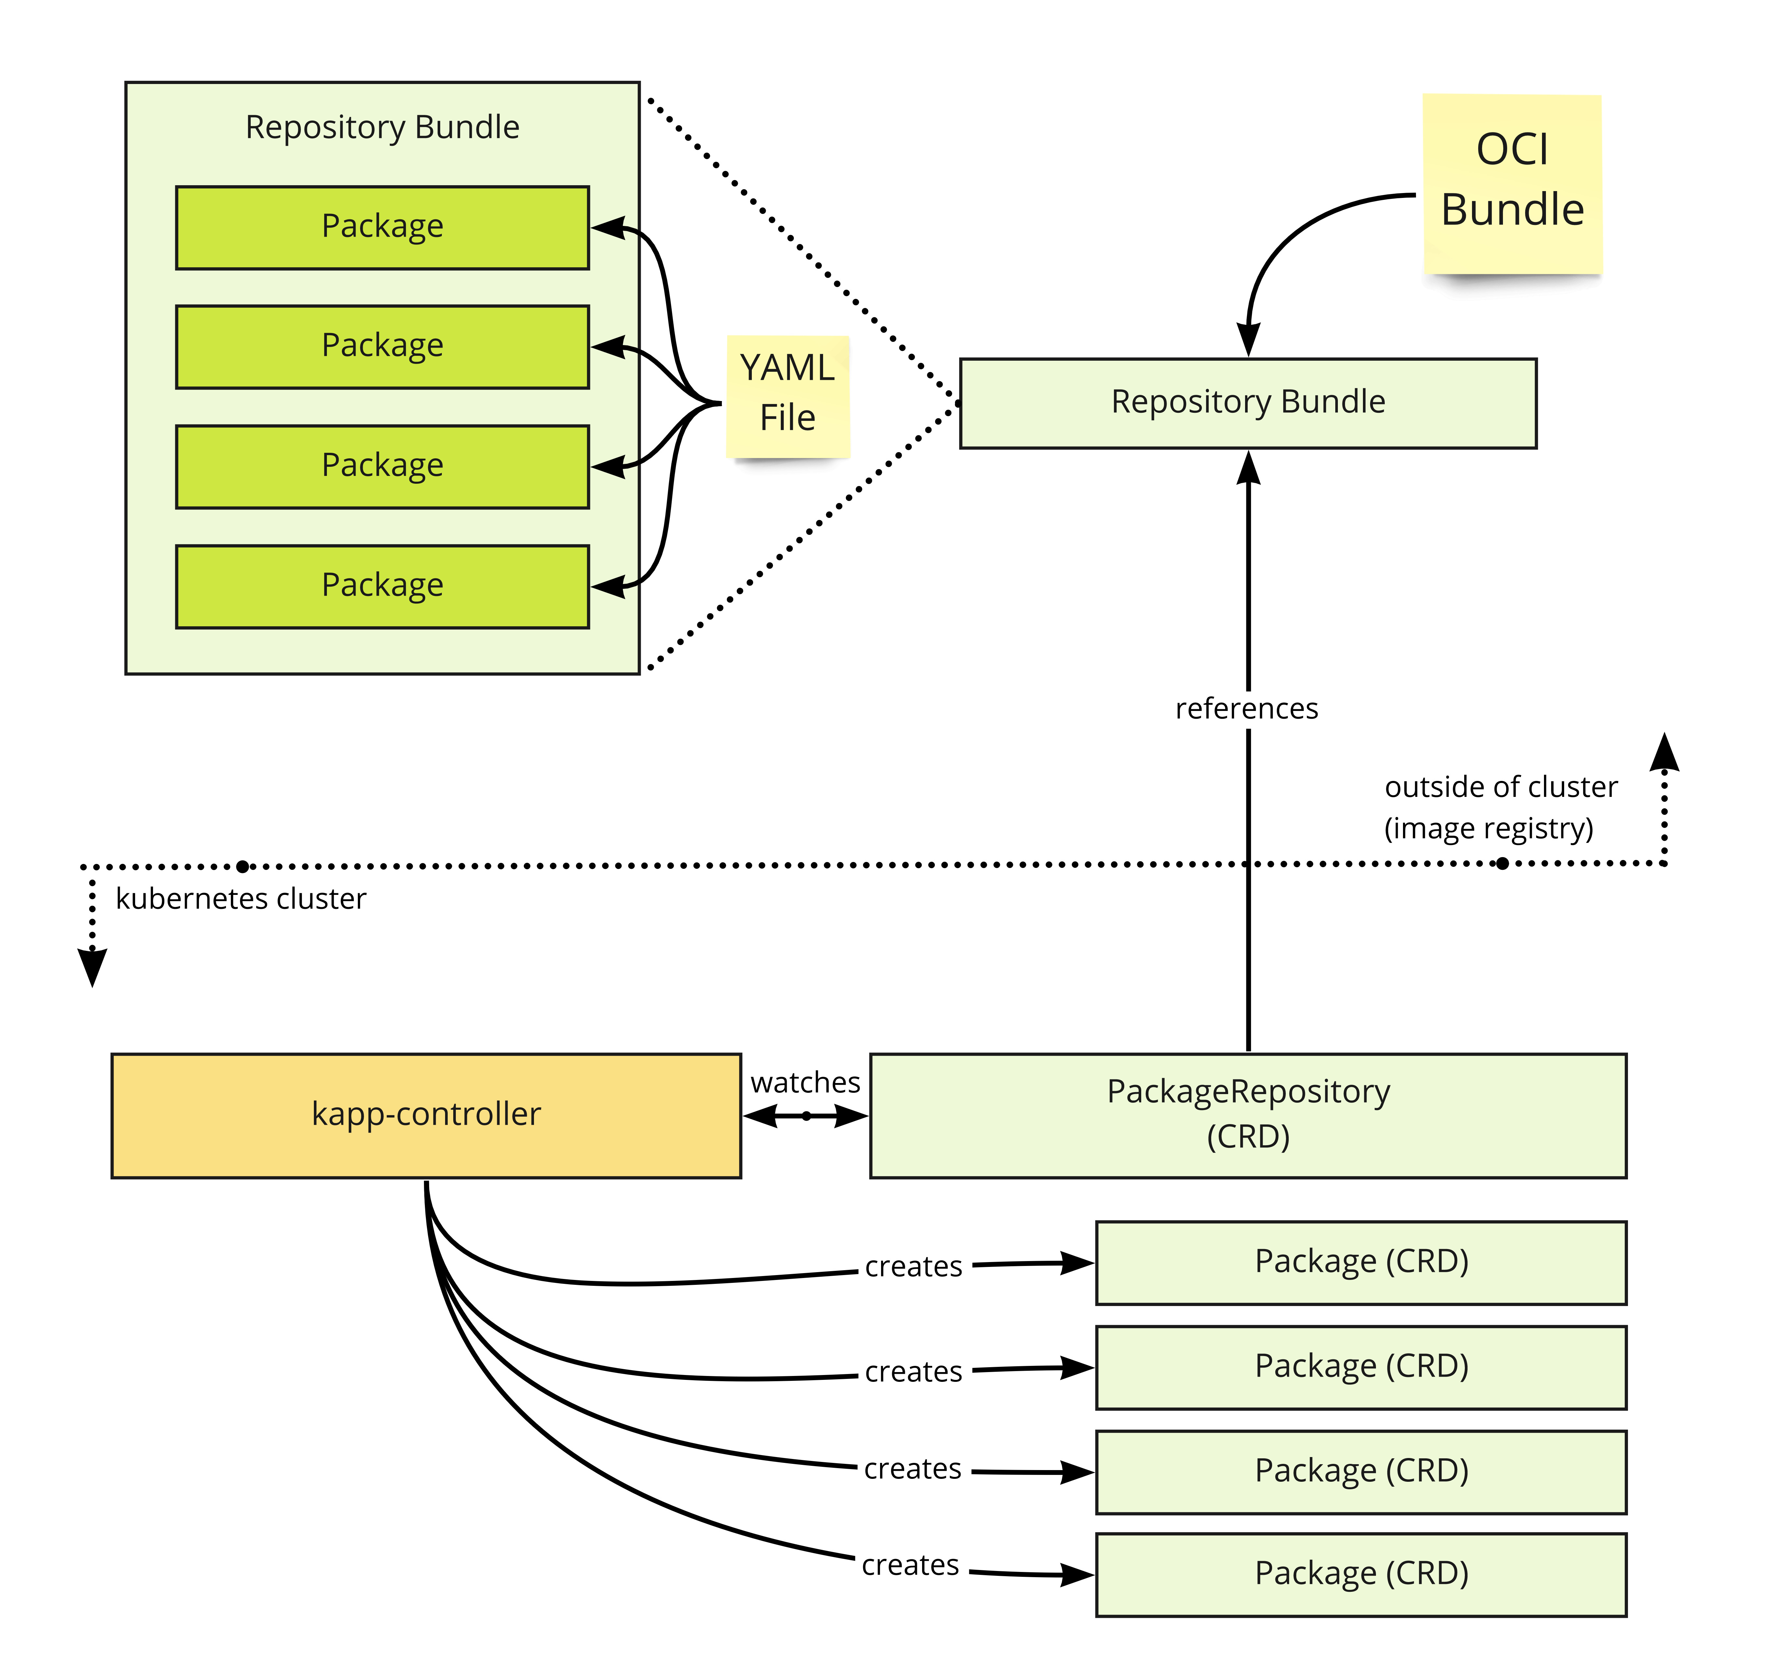
Package repository

Slide 16
Demo

Slide 17
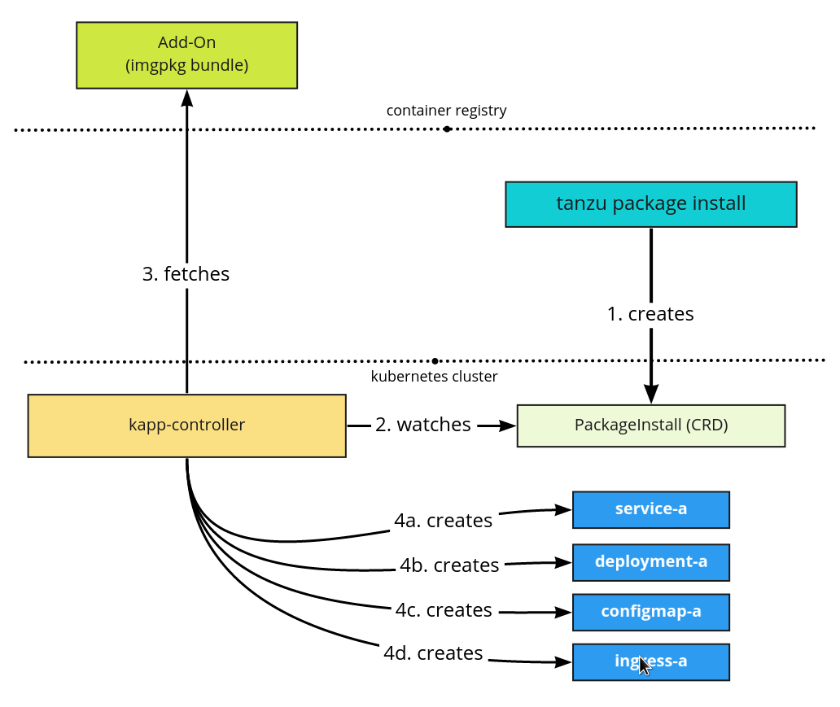
Package install

Slide 18
Demo

Slide 19

Learn more
https://tanzu.vmware.com/get-started
https://tanzucommunityedition.io/
https://kube.academy
https://rudimartinsen.com/
https://github.com/rumart/vmugdk-may-22
https://beyondelastic.com/2022/01/04/tanzu-packages-explained/

